Slide 1
Functional Breathalyzer
Jake Lyle

Slide 2
Goal:
Detect is one is ‘functionally’ sober
Legal sobriety limit = 0.08 BAC
‘Functional’ sobriety limit = No word slurring

Slide 3
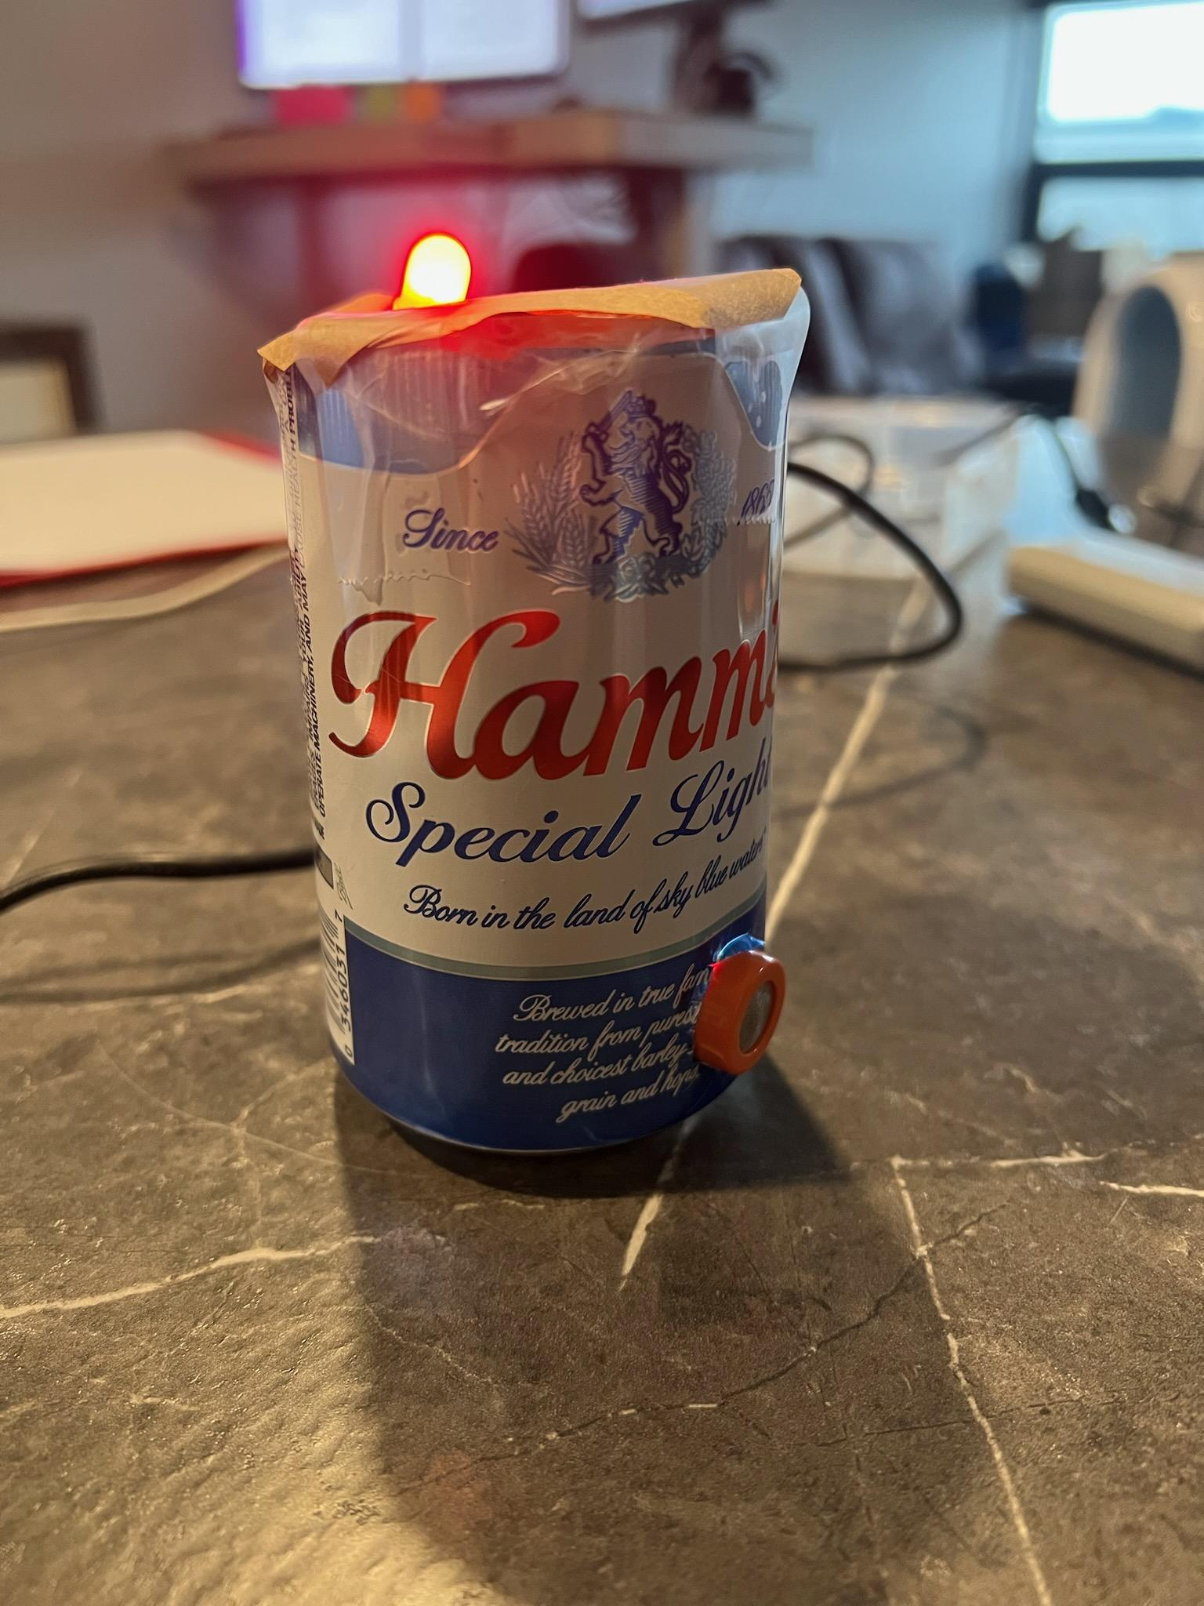

Slide 4
Parts, Sensors & Software
MQ-3 Sensor
Chainable RGB LED
Arduino BLE Sense 33
Various Wires
Edge Impulse
Mobile phone

Slide 5
Goal: Detect if someone is ‘functionally’ sober
Inputs: Reading from MQ-3 sensor, microphone
Output: Prediction of sobriety/ drunkenness via RGB light

Slide 6
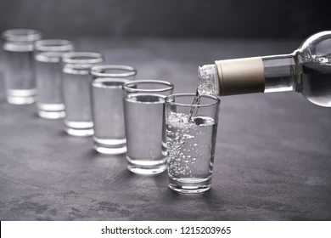
Data Collection
2 of my close friends were shown random words
33% chance of:
Specificity
Transubstantiation
Other (list of 15 random 8+ letter words
Recorded before drinking
Recorded after ~3 hours
Taking a shot every 30 minutes
Data collected w/ mobile phone via Edge Impulse

Slide 7
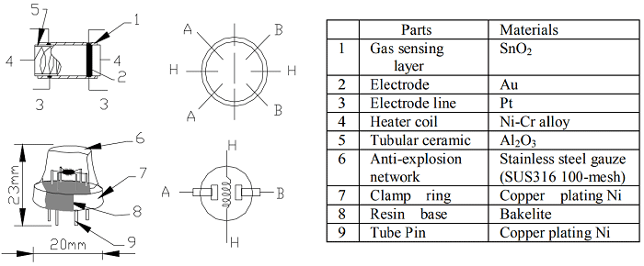
MQ-3 Sensor
Tin-Oxide layer interacts w/ gas
Conductivity is correlated to concentration
Electrical resistance is transmitted to analog output
Source: https://components101.com/sensors/mq-3-alcohol-gas-sensor#:~:text=MQ%2D3%20gas%20sensor%20has,with%20the%20gas%20concentration%20rising.

Slide 8
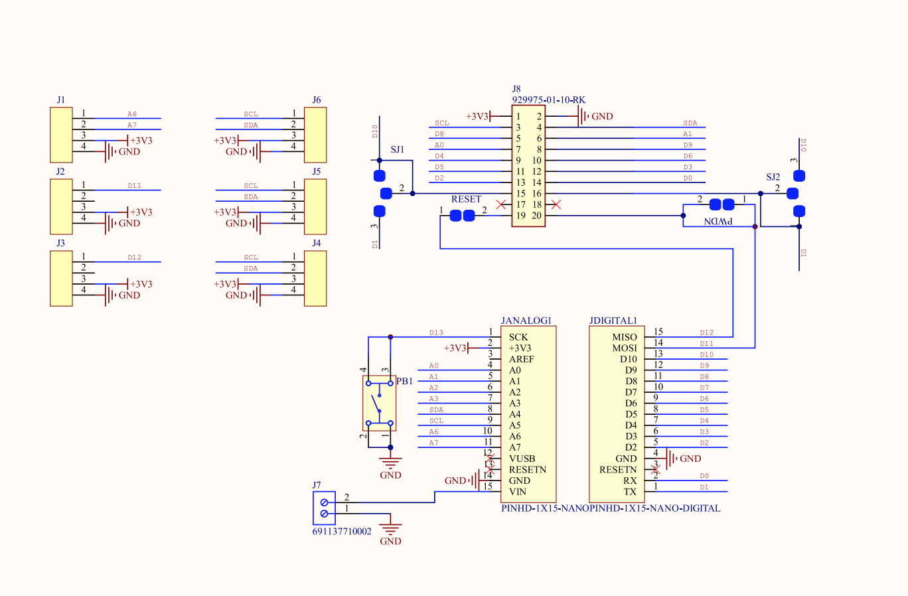
MQ-3 Sensor (A6,A7)
RGB (A0,A1)
BLE Sense 33

Slide 9
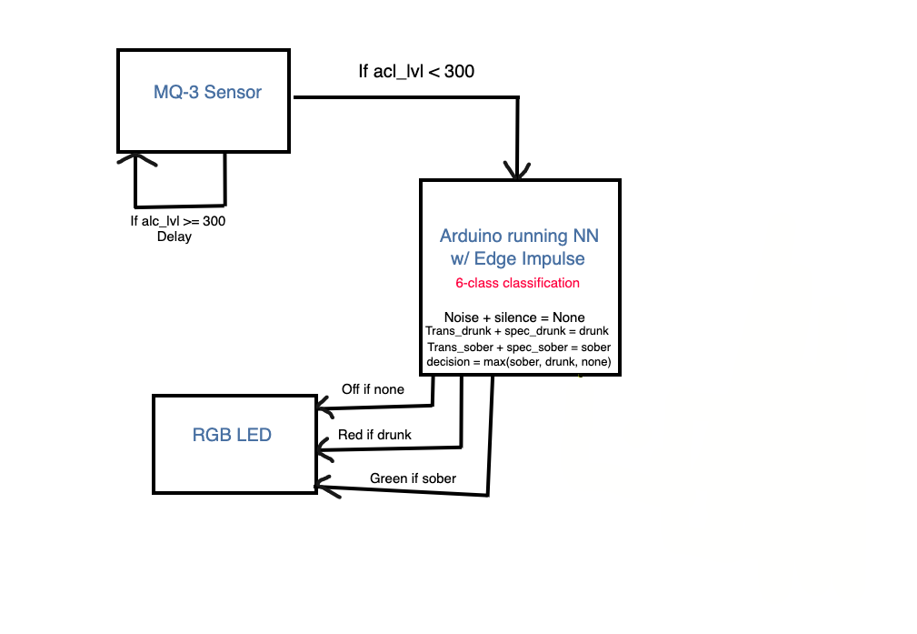

Slide 10
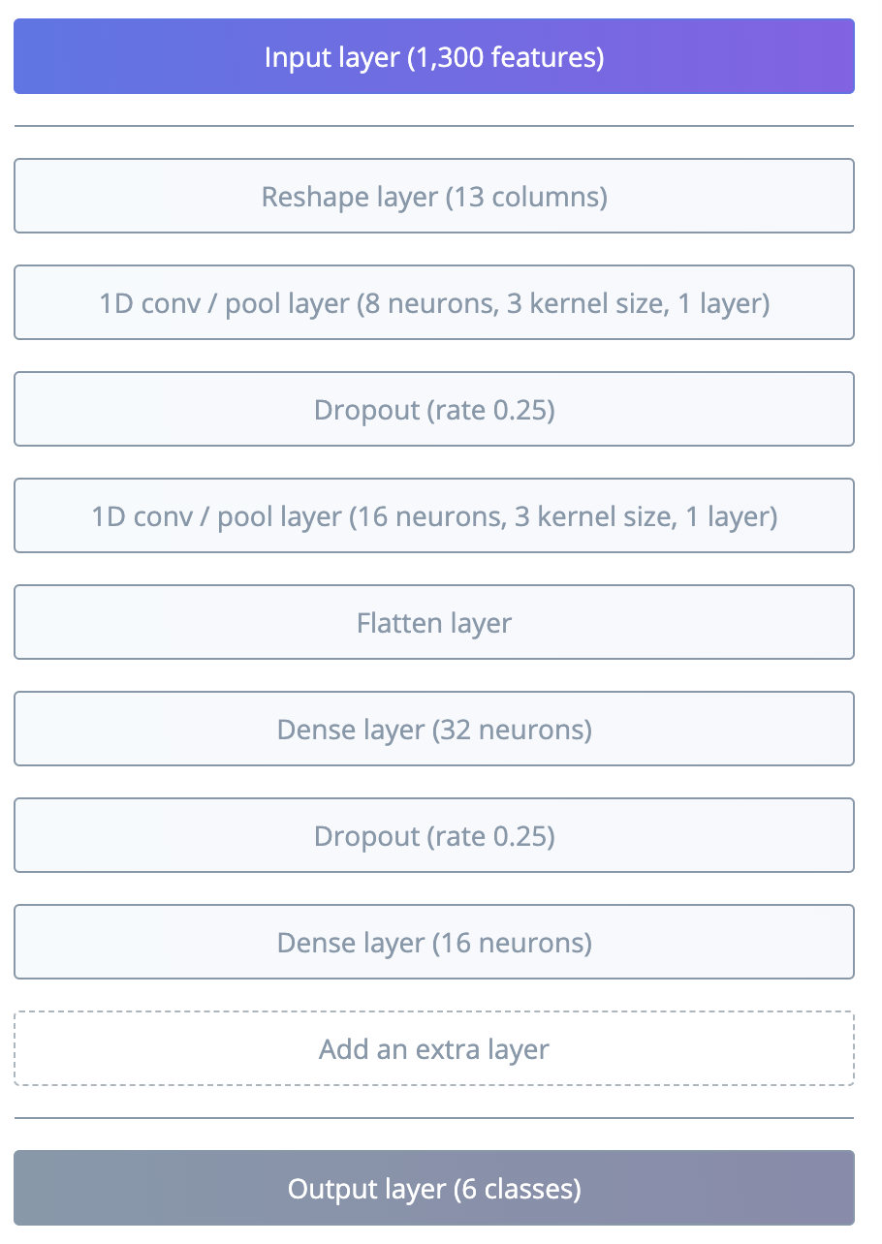
Model

Slide 11
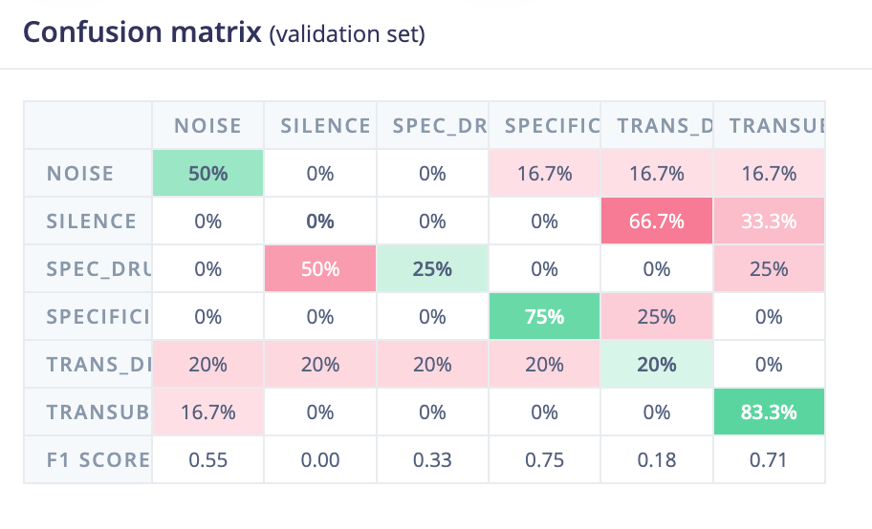
Performance

Slide 12
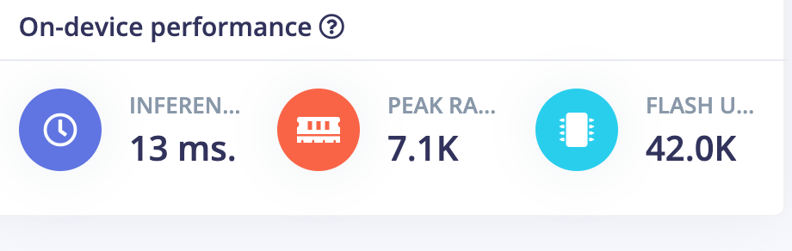
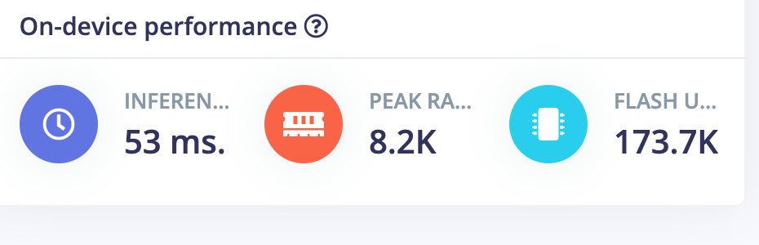
Issue

Slide 13
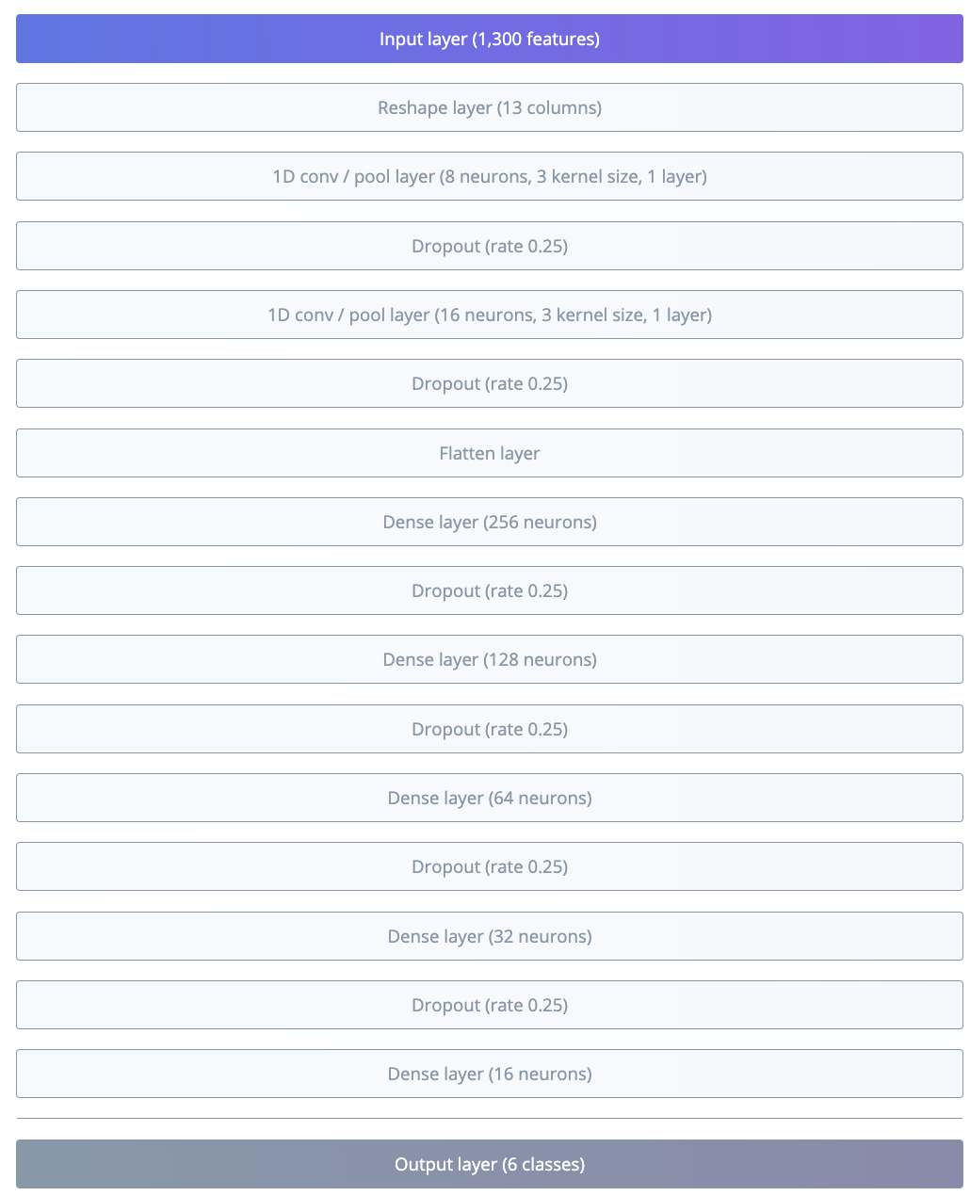

Slide 14
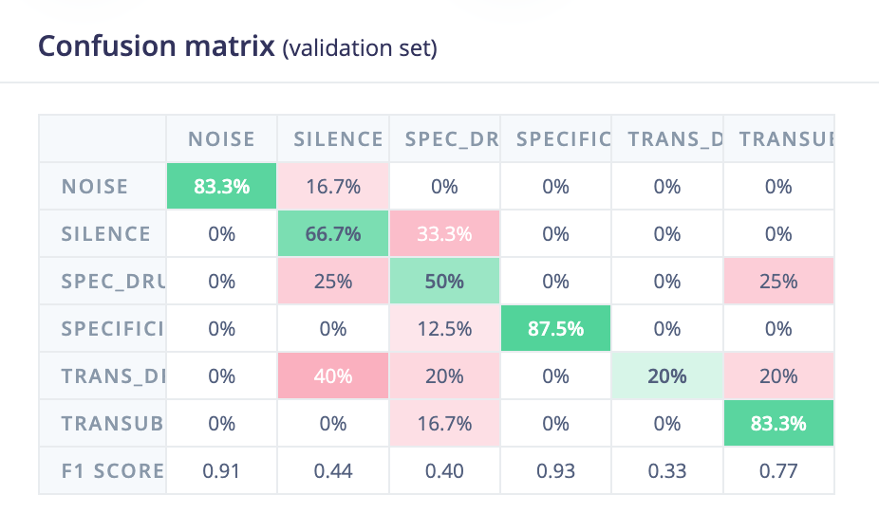

Slide 15
Next Steps
Improve model performance
Improve detection/ input of alcohol sensor
Include facial/ eye tracking model w/ camera
Fit parts inside a more appealing device

Slide 16
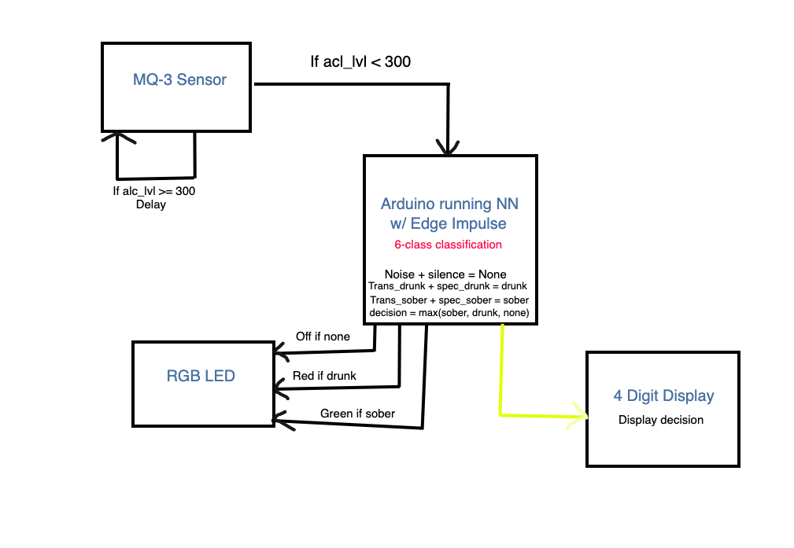
Next Steps

